Slide 1
Chapter 9
COUNTER/TIMER PROGRAMMING IN THE 8051

Slide 2
Outlines
List the timers of the 8051 and their associated registers
Describe the various modes of the 8051 timers
Program the 8051 timers to generate time delays
Program the 8051 counters as event counters

Slide 3

PROGRAMMING 8051 TIMERS
Timer 0 registers
TL0 ( timer 0 low byte )
TH0 ( timer 0 high byte )

Slide 4

Timer 1 registers
TL1 ( timer 1 low byte )
TH1 ( timer 1 high byte )

Slide 5

TMOD (timer mode) register

Slide 6


Slide 7



Slide 8


Slide 9

Mode 1 programming
1.Loaded value into TL and TH
2.”SETB TR0” for timer 0 ;”SETB TR1” for timer 1
3.If TF (timer flag) = high “CLR TR0” or “CLR TR1”
4.Reloaded TH and TL value, TF reset to 0

Slide 10
Steps to program in mode 1
1.Load the TMOD value
2.Load registers TL and TH
3.Start the timer (SETB TR0 or SETB TR1)
4.Keep monitoring the timer flag (TF)
5.Stop the timer (CLR TR0 or CLR TR1)
6.Clear the TF flag
7.Go back to step 2

Slide 11

Calculate Timer Delay

Slide 12


Slide 14
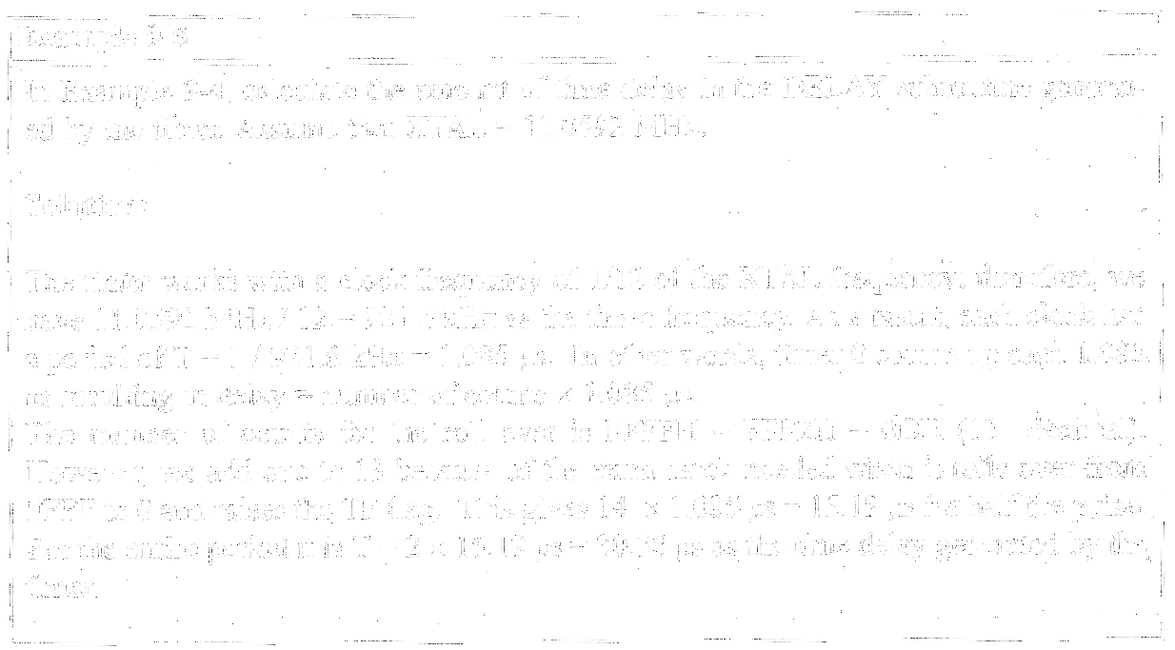

Slide 15


Slide 16


Slide 17


Slide 18


Slide 19
Finding values to be loaded into the timer
Assuming XTAL =11.0592MHz from Example 9-10
1.Divide the desired time delay by 1.085μs
2.Perform 65536-n, where n is the decimal value we got in
Step 1
3.Convert the result of Step 2 to hex, where yyxx is the
initial hex value to be loaded into the timer’s registers
4.Set TL = xx and TH = yy

Slide 20
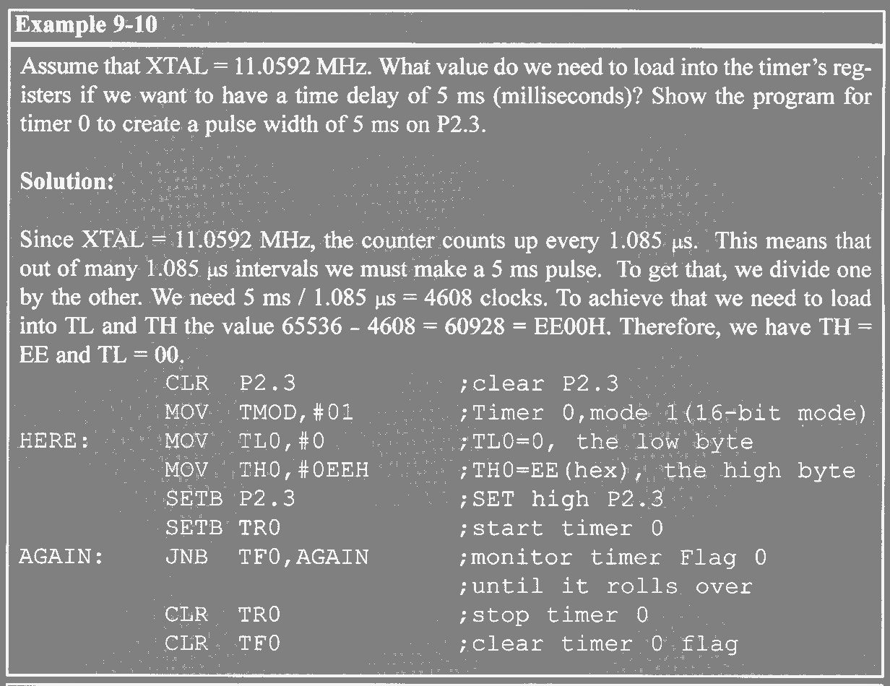

Slide 21


Slide 22


Slide 23
Mode 0
Like mode 1 except that it is a 13-bit timer
Mode 2 Programming
1.Loaded value into TH (8-bit timer)
2.”SETB TR0” for timer 0 ;”SETB TR1” for timer 1
3.If TF (timer flag) = high “CLR TR0” or “CLR TR1”
4.Reloaded TL value kept by TH

Slide 24
Steps to program in mode 2
1.Load the TMOD value
2.Load the TH registers
3.Start the timer
4.Keep monitoring the timer flag (TF)
5.Clear the TF flag
7.Go back to step 4

Slide 25
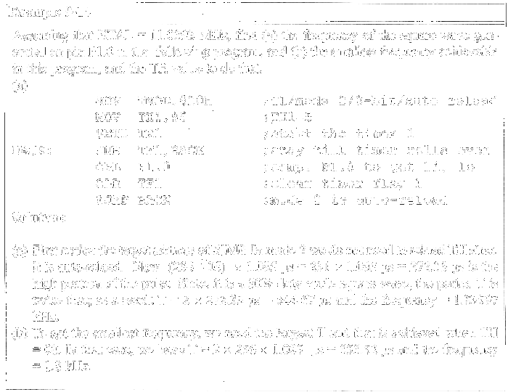

Slide 26
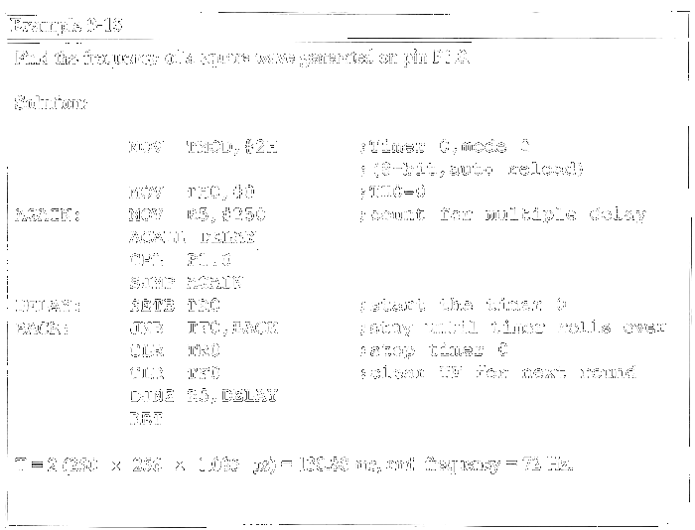

Slide 27
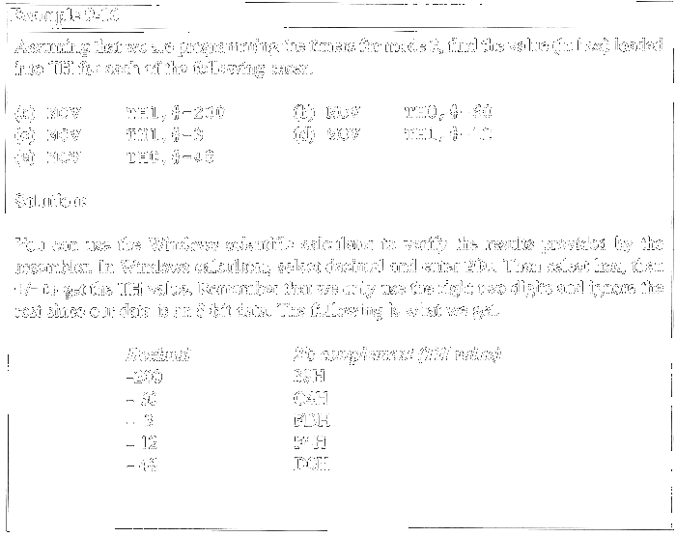

Slide 28
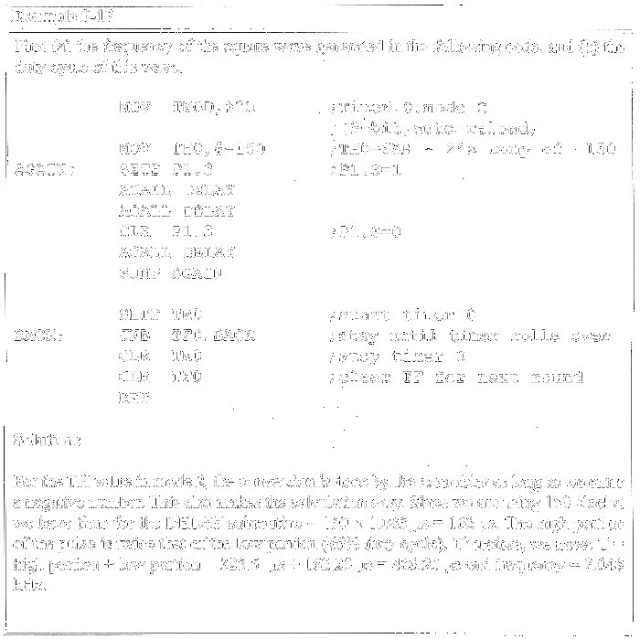

Slide 29
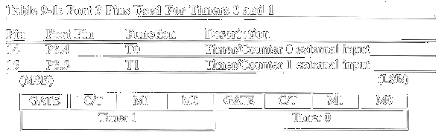
C/T bit in TMOD register

Slide 30
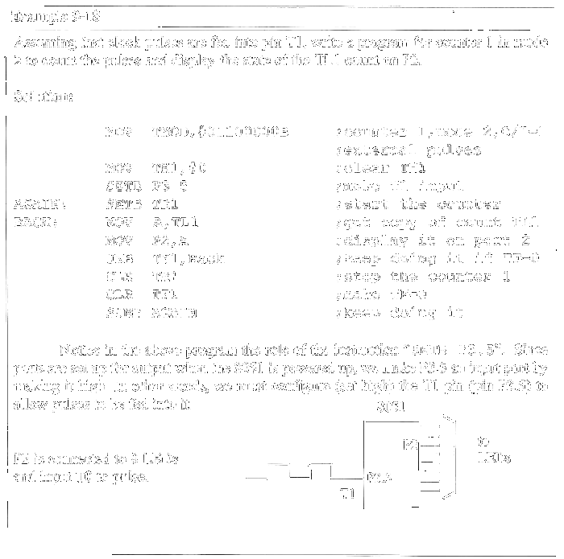

Slide 31
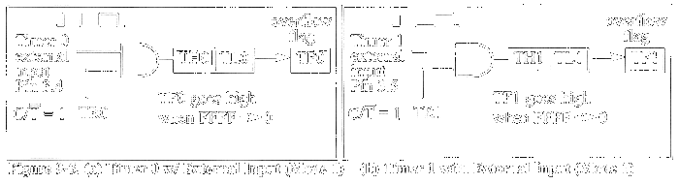

Slide 32
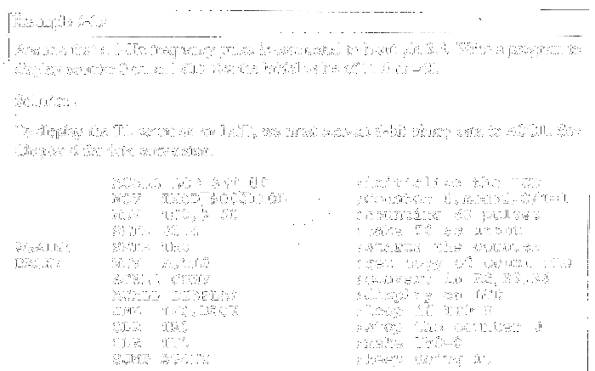

Slide 33
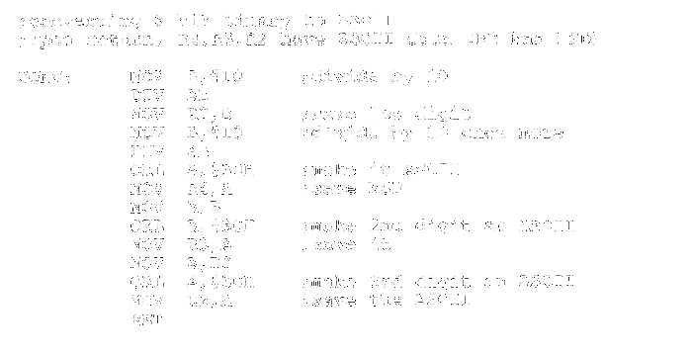

Slide 34
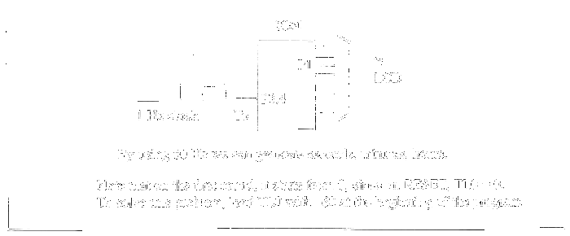

Slide 35
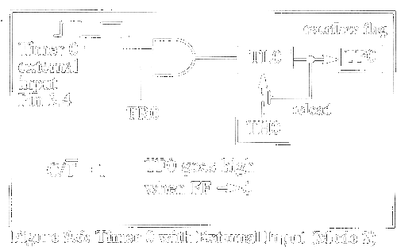
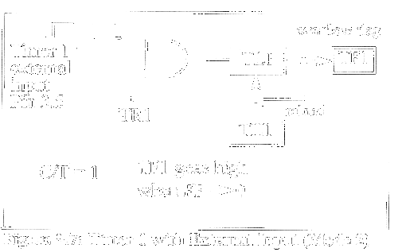

Slide 36
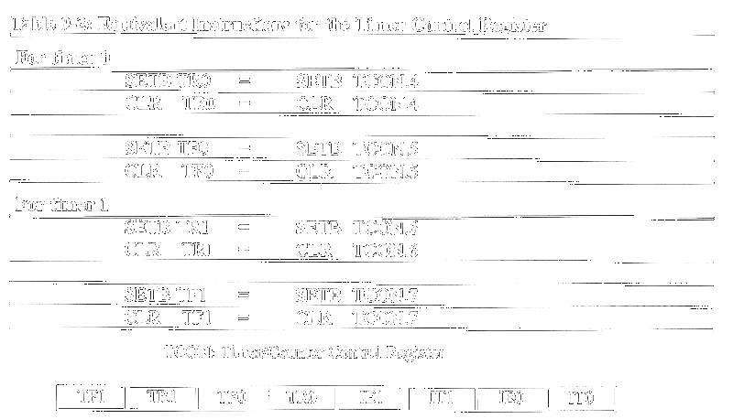

Slide 37

The case of GATE =1 in TMOD

Slide 38
